Slide 1

Chairs are from
Mars
Deans are from Pluto
Can you have a relationship?

Slide 2
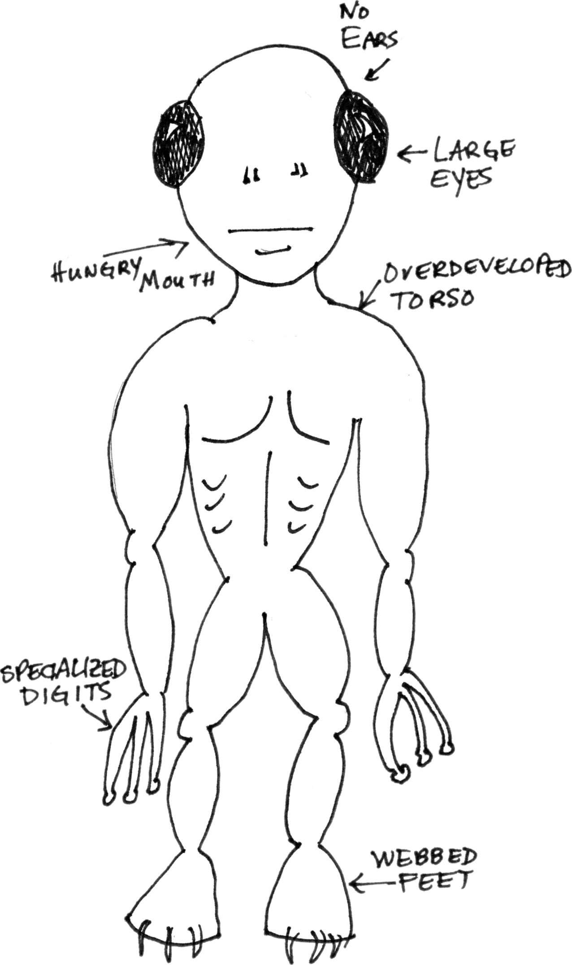
Your Dean Is
An Alien Creature
For all practical
purposes, that is.
If you treat the Dean as such and try to learn how it thinks, what it feeds on, what language it speaks, what motivates it, etc., you will probably get along.

Slide 3

Listen to your Dean
Learn its
language.
The dean will use
bizarre terms
like FTE, SCH, accountability,
resource allocation, faculty
assignment, etc.
Even stranger, the dean will refer in your conversation to other departments and other colleges.

Slide 4

Learn the Language
Old Psycholinguistics theory – you think according to the language you speak.
You will understand the dean’s perspective: it wants to maximize the college’s prospects in the context of
the university.
To do that, you must
understand the
college context and
university context.

Slide 5

Fly on the
Wall
Chair: We have a retirement at the
end of the AY, so I need an
authorization for another line,
preferably senior.
Dean: Before we talk about lines, let’s revisit our conversation from 6 months ago about SCH production. Your faculty average 60 SCHs per class. Currently, Florida funds SCH growth, and we discussed improving productivity.
Chair: If you give me another line, that will be 4
classes x 60 SCHs = 240 more SCHs !!

Slide 6

Therein lies the duel
The Chair wants to maximize the department’s prospects (and maybe his own)
The dean wants to maximize the College’s, and that may or may not include maximizing your department’s
THAT’S OK – is it in the dean’s interest to maximize your department’s fortune?

Slide 7
Resources
The Dean has finite resources.
It allocates them for maximum
bang per buck. A good Dean
makes hard choices.
You need to show the Dean
good return per dollar:
  Teaching
  Research
  Service
Don’t make the mistake of thinking you have any structural or moral ENTITLEMENT to the resources.

Slide 8
Fly on the
Wall
Science Chair: Science
dept. X in the next building
gets $100K per year to fund
research efforts and faculty development. (1) We teach as many students as they do. (2) We have more faculty than they do. I need the same allocation, preferably bigger.
Why might this not be a compelling argument?

Slide 9

How to Get Resources
When you want something, do you bring something to the table?

Slide 10
Fly on the
Wall
Chair: I really want to upgrade instructional computer resources. I need $20K. I have $10K returned from a faculty member buying herself out on a grant. I will put that $10K towards the needed resources if you will help me out with the other $10K.

Slide 11
How to Get Resources (cont’d)
Do you prioritize?
Do you make hard choices?

Slide 12
Fly on the
Wall
Chair: The faculty voted overwhelmingly to divide up
pretty much everything equally: travel money, research money, plum committee assignments, teaching duties. I find this keeps the peace well.

Slide 13
How to Get Resources (cont’d)
Are you a member of the Dean’s team?
Or are you solely an advocate of the faculty?
Have you mastered the facts?

Slide 14
Aliens are only Human, after all
Do you follow through on agreements?
Are you honest and reliable?

Slide 15
Aliens are only Human, after all
Do you whine?
Do you push the Dean’s buttons?
Do you lose your cool periodically?

Slide 16

Intergalactic Relations
Are you a
credit or an embarrassment when you represent the College?
What have you done for the Dean lately?

Slide 17

Galactic Peace
Do you raise everything to the dean’s level or only the things that need to be there?
Do you keep the Dean informed of good news?

